Slide 1


GIT ASSIGNMENT
Submitted By : Naincy kumari
Team : Falcon
Emp ID : 1593

Slide 2

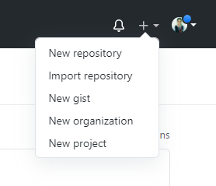
Create and Collaborate on a new empty repository :
www.knoldus.com
1. In the upper-right corner of any page, use the drop-down menu, and select New repository.
2. Type a short, memorable name for your repository. For example, "assignment". Then Click Create repository.

Slide 3
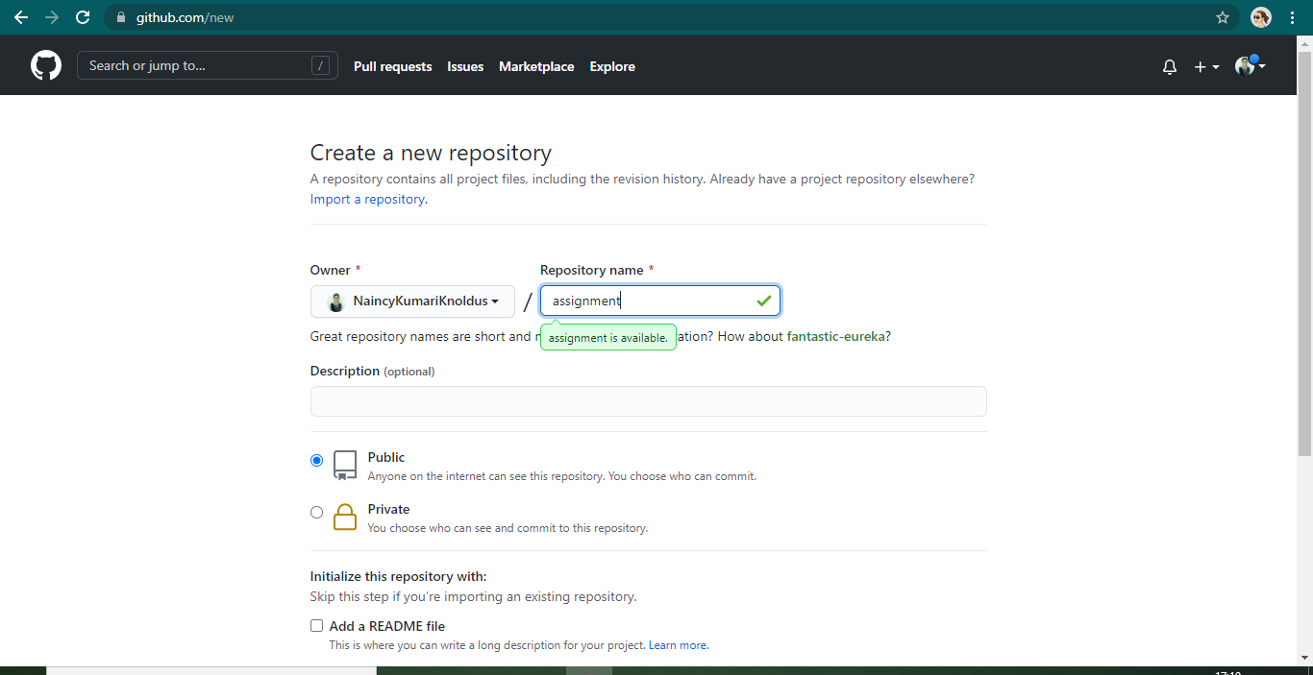
www.knoldus.com
My new Remote repository is created in github.
git init : Transform the current directory into a Git repository

Slide 4
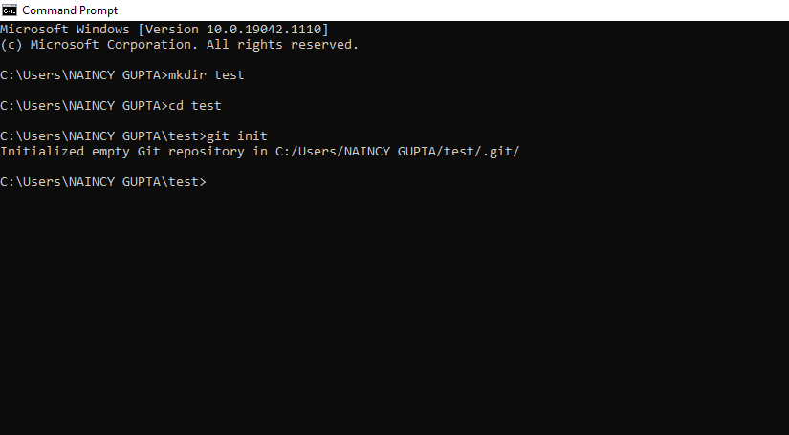
www.knoldus.com
git status : displays the state of the working directory and the staging area.
Now adding one text file in your test file naming demo.txt. And do some changes in that file to commit.

Slide 5
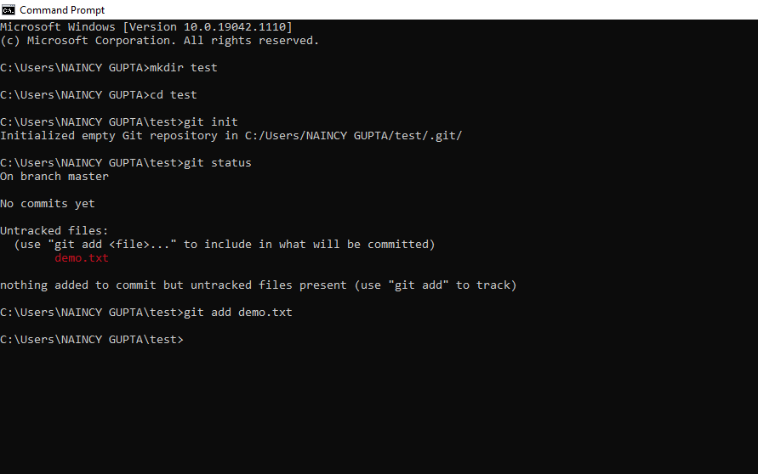
www.knoldus.com

Slide 6
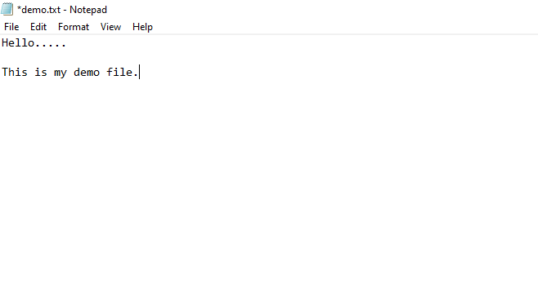
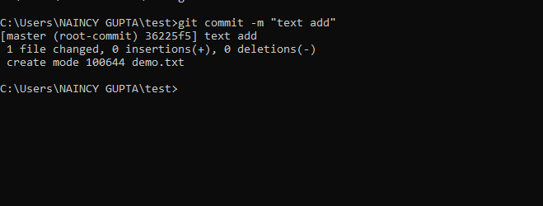
www.knoldus.com
git add : adds new or changed files in your working directory to the Git staging area.
Commit
git commit : creates a commit, which is like a snapshot of your repository.

Slide 7
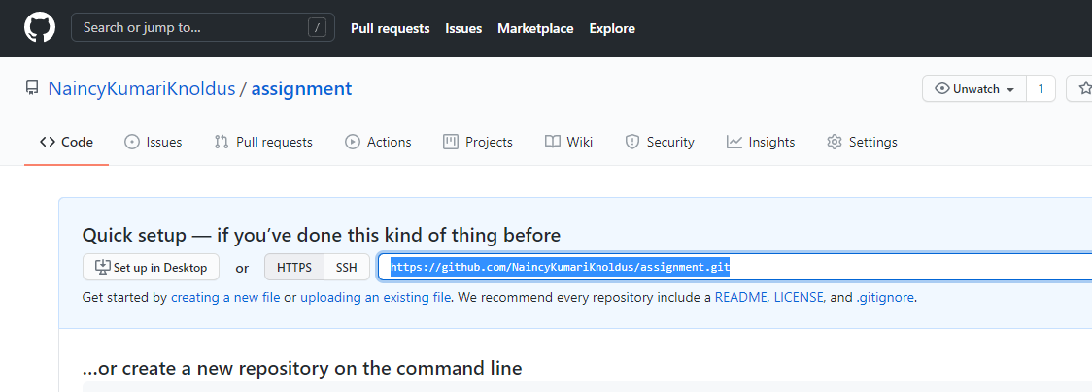
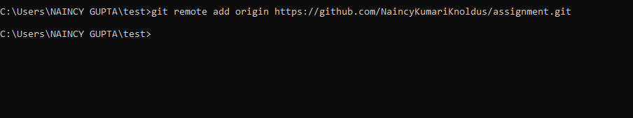
www.knoldus.com
Now copy link of remote repository.
git remote add origin <link> : Link local and remote repository

Slide 8
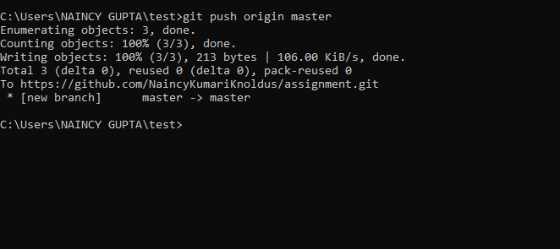
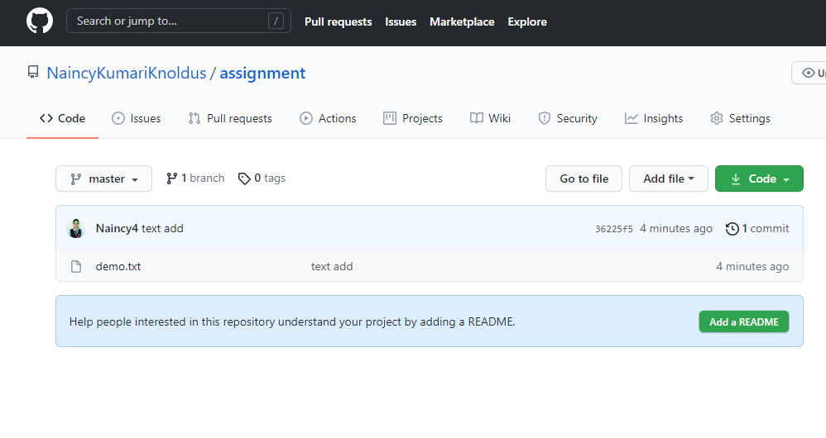
www.knoldus.com
git push origin master : used for pushing local content to GitHub

Slide 9
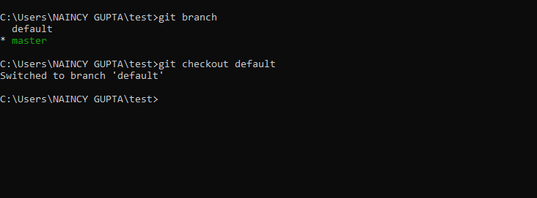
Checkout
git checkout : lets you navigate between the branches created by git branch .

Slide 10
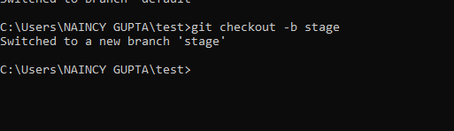
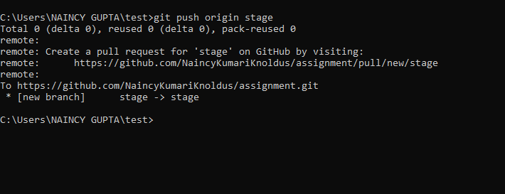
git checkout -b <branchname> : create a new branch and switch to that new branch.

Slide 11
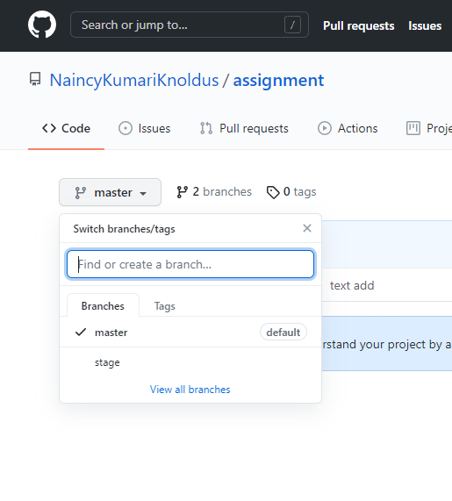
git push origin <branchname> : it will push the new branch to a remote repository.

Slide 12

Thank You!

